Slide 1
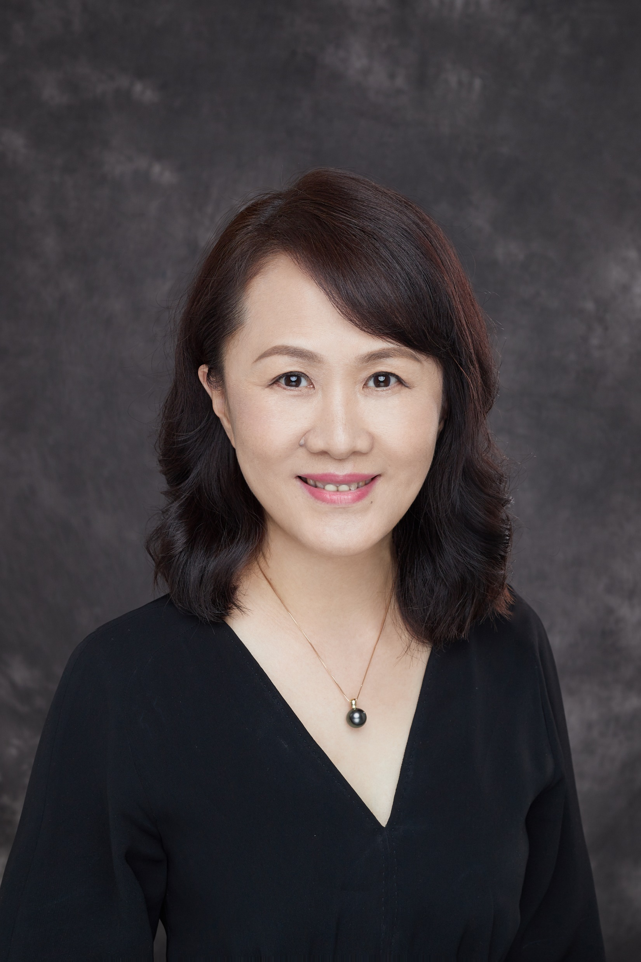
Personal Profile
Director of Department of Pulmonary and Critical Care Medicine, China-Japan Friendship Hospital, Chief Physician, Master Tutor, Professor
Chairman of Pulmonary Rehabilitation Committee, China Association of Rehabilitation of Disabled Persons
Vice chairman of Pulmonary Rehabilitation Committee, Chinese Association Rehabilitation Medicine
Vice chairman of Dysphagia rehabilitation Committee, Chinese Association Rehabilitation Medicine
Vice chairman of Pulmonary Rehabilitation Committee, World Federation of Chinese Medicine Societies
Deputy editor of Thorax (Chinese)
Standing Committee Member of Technical Committee of Respiratory Equipment, China Association of Medical Equipment
Chairman of Pulmonary Rehabilitation Committee, Rehabilitation Doctor Committee, Chinese Medical Doctor Association
Vice chairman of respiratory related career development committee, Chinese Association of Chest Physicians, Chinese Medical Doctor Association
Committee of Cardiopulmonary Rehabilitation Group, Chinese Society of Physical Medicine and Rehabilitation
Committee of Critical Care Medicine Group, Chinese Association of Chest Physicians, Chinese Medical Doctor Association
Committee of Respiratory Society, Chinese Geriatrics Society
Won the first prize of provincial and ministerial outstanding scientific research achievements

